Slide 1
Welcome!
The webinar will begin at
2:00 Eastern/11:00 Pacific

Slide 2
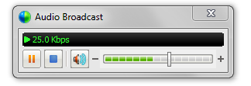
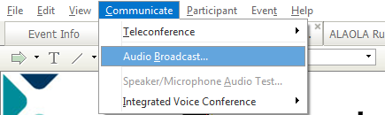
Audio Tips
Today’s audio is streaming to your computer’s speakers or headphones.
Too loud or soft? Adjust volume level in the Audio broadcast box:
Lost all sound? Hear an echo? At the top of the screen, go to the Communicate menu and select Audio Broadcast to refresh your connection.
Notes:
2

Slide 3
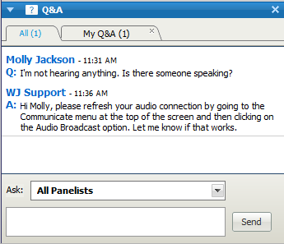
Need Help?
Please post technical support questions into the Q&A Panel.
Step 1: Type the problem in
the dialog box.
Step 2: Click Send.

Slide 4
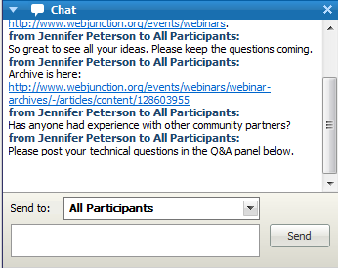
Chat Etiquette
Use Chat to talk with attendees and presenters about the topic.
Do not post technical questions to Chat.
And if you’re tweeting, use this hashtag: #libedevice

Slide 5
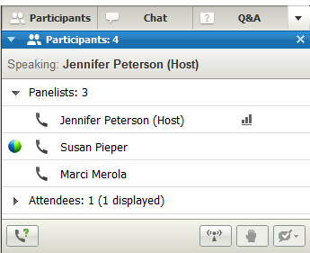
Telephone Access
If you not able to listen via your computer, you may join by phone.
Step 1: Click on Phone Icon under the Participants list.
Step 2: Call the toll-free number provided.
Step 3: Enter the Access Code and Attendee ID provided.
Notes:
http://www.webjunction.org/membercenter/userguide#webex

Slide 6
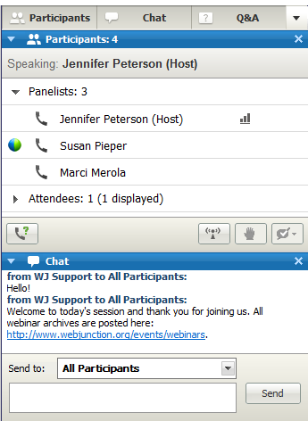
Customize your experience
Panels can be opened or closed by clicking on the panel name at the top of the column, or by using the X in the individual panel.
Hover over edge of
panels to drag and resize.

Slide 7
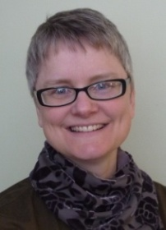
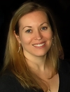
Remember to post to Q&A panel if you need technical assistance.
Other Technical problems?
Contact WebEx support
Event Number: 717 919 875
Phone: 1-866-229-3239
Co-Produced by:
Jennifer Peterson
WebJunction Community Manager
Produced by:
Kendra Morgan
WebJunction Senior Programs Manager
Notes:
7

Slide 8

Thanks to the generous support of the following state library agencies, WebJunction offers webinar programs for free to all who wish to attend:
Arizona State Library, Archives and Public Records
Connecticut State Library
Florida Department of State’s Division of Library and Information Services
Georgia Public Library Service
Idaho Commission for Libraries
Illinois State Library
Indiana State Library
State Library of Kansas
Maine State Library
Minnesota State Library Agency & Minitex
Missouri State Library
State Library of North Carolina
State Library of Ohio
Access Pennsylvania
Texas State Library & Archives Commission
Library of Virginia
Washington State Library
Special thanks to all who participate in WebJunction’s LinkedIn conversations on today’s topic! http://www.linkedin.com/groups/WebJunction-1814025

Slide 9
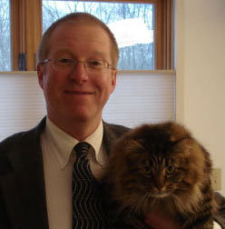
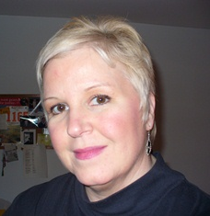
Today’s Presenters
David Newyear Manager,
Branch Services,
Mentor Public Library,
Ohio
Ming Heraty Manager, Reference & Advisory Services, Arlington Heights Memorial Library, Illinois

Slide 10
Mentor Public Library eDevice Policies
David Newyear
Mentor Public Library
Manager Branch Services
MOL Branch Library
david.newyear@mentorpl.org
www.mentorpl.org

Slide 11
About our library
Main Library and two Branches
Population of 65,000
33,000 registered borrowers
Circulation of 1.3 million in 2010
Staff of 40
Bargaining unit - SEIU

Slide 12
Who thought of circulating eReaders?
The idea originated with our Director and Board of Trustees in late December 2009.
MPL had been part of the Ohio eBook Project.
No downloadable media.

Slide 13
Concerns in January 2010
Which device(s) should we offer?
How do we keep the devices secure?
How can we circulate them without damage?
How do we manage Amazon or B&N accounts?
Should patrons be able to purchase or download content?
How do we catalog the content?
Which library staff will be responsible for check in, check out, maintenance and support?

Slide 14
We didn’t want to re-invent the wheel…
Contacted other libraries circulating eReaders in January-February 2010
We felt that Mead Public Library had well written policies and used them as a model: http://www.meadpubliclibrary.org/policies?nid=882
We also implemented an eDevice Policy and User Agreement.
The original policy was presented to the Board in April 2010; resolution #10-053 passed the revised policy to include iPads.

Slide 15
MPL eDevice Guidelines
http://www.mentorpl.org/pdfs/Electronic%20Device%20Circ%20Guidelines.pdf
Who can check out eDevices
Check out/check in procedures
Loan periods
Breakdown of costs
Borrower/Staff responsibilities

Slide 16
User Agreement
http://www.mentorpl.org/pdfs/Electronic%20Device%20Circ%20Agreement.pdf
Verifies that the borrower is an adult
Verifies that the borrower has read our Electronic Device Guidelines and User Agreement and agrees to abide by them
Borrower accepts financial responsibility for the device and agrees not to tamper with it

Slide 17
User Agreement
Name
Address
Unique ID (drivers license, State ID)
Signature
MPL card number
Date
Staff and borrower confirmation that the device is working and that all parts are present

Slide 18
We chose Nooks,
Somewhat easier account maintenance
Each title could be shared on up to six Nooks
Nook received better reviews
Partnering opportunity with the local Barnes & Noble
4 Nooks circulating in April 2010

Slide 19
but quickly expanded our collection…
2 iPads in May, 2010
2 additional Nooks in June, 2010
6 additional Nooks in August, 2010

Slide 20
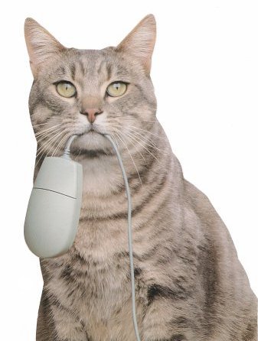
to include downloadable media,
Freegal live in late December 2010
Overdrive live on May 31, 2011

Slide 21
laptop computers, and other devices.
20 laptop computers for in-house use were purchased through a technology grant from the Lake-Geauga Fund of the Cleveland Foundation in July, 2011
4 iPad2s in November, 2011
4 Kindle Fires in November, 2011

Slide 22
Devices at the MOL Branch
3 laptop computers transferred from MPL Main Library to MOL Branch for in-house use in January, 2012
4 Nook Simple Touches for MOL Branch circulation starting in February 2012

Slide 23
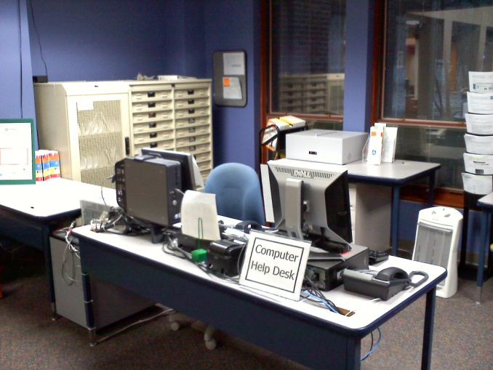
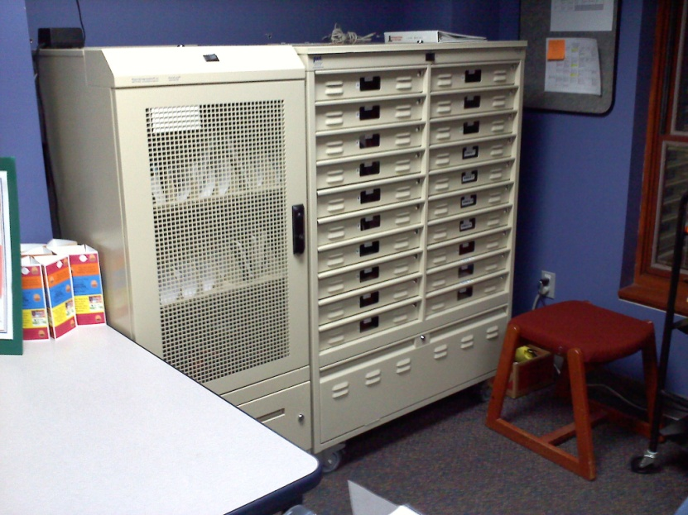
Where do the devices live?
The Nooks were originally kept behind the circulation counter.
As the number of devices increased, cabinets were installed behind the Computer Help Desk.

Slide 24
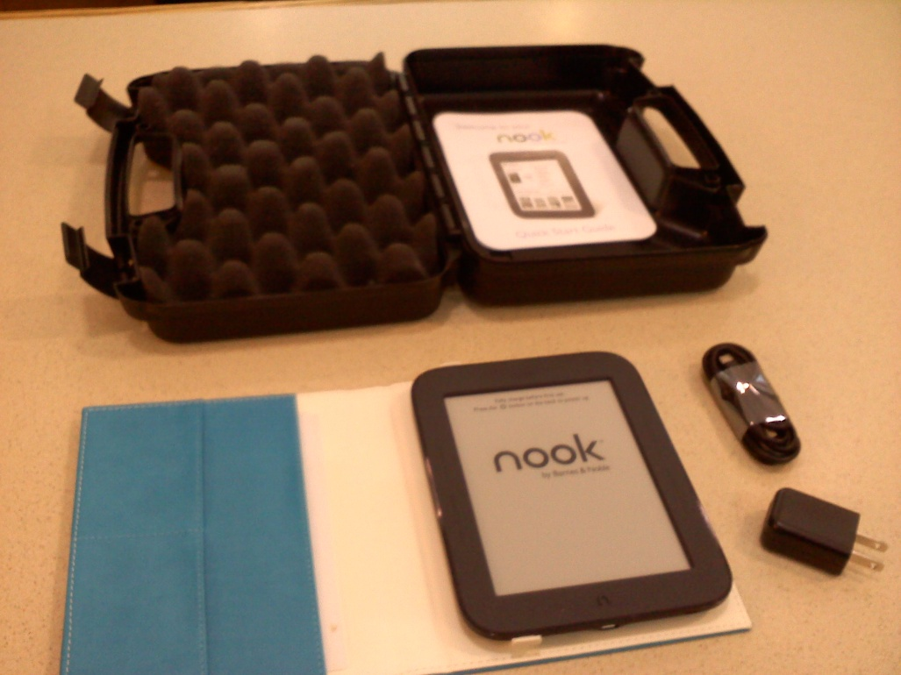
Packaging
eDevice “kits” in hard shell cases
Must be returned to the Computer Help Desk, never in the book drop!

Slide 25
Who takes care of them?
Circulation - originally circulation staff, then reference staff (PSCs)
Maintenance/support/troubleshooting – reference/IT staff.
Account management – reference/IT staff manage accounts - Amazon, Apple, B&N

Slide 26
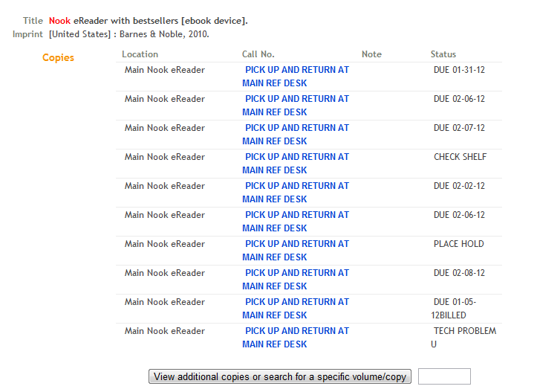
Webpac - Nooks

Slide 27
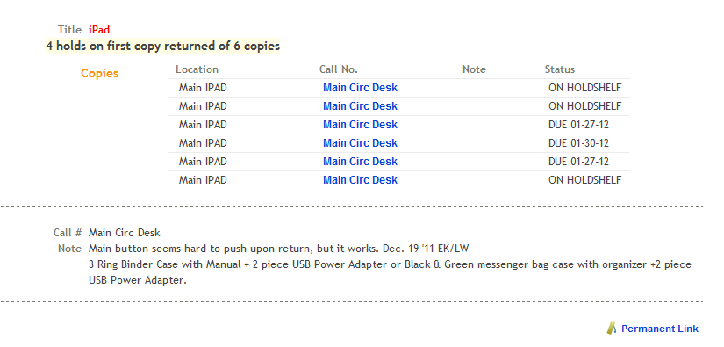
Webpac - iPads

Slide 28
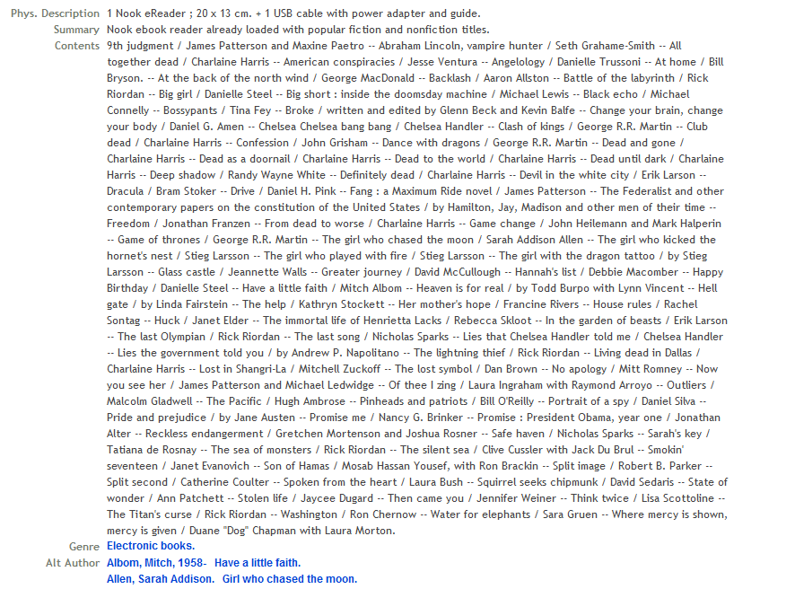
Nook content

Slide 29
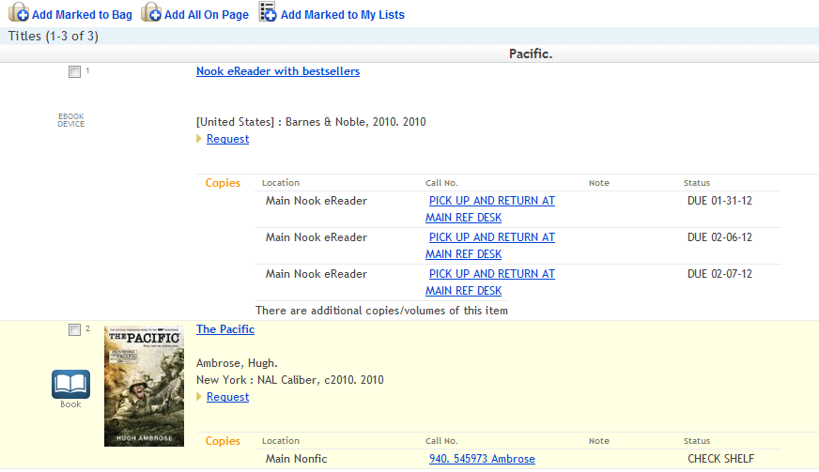
Title search results including Nook

Slide 30
What can patrons do with them?
All Nooks have the same content – approximately 130 bestselling fiction and nonfiction titles.
Assorted apps on the iPads
Assorted apps and free eBooks on the Kindles
Password purchase protection
iPads and Kindles are restored to factory settings between borrowers.

Slide 31
Changes to the Electronic Device Guidelines
“Nook Guidelines” became “Electronic Device Guidelines” as MPL added circulating iPads, laptops, Kindle Fires, Sony eReaders, and Nook Simple Touches.
Check in/check out procedures added
Responsibility for eDevices shifted from circulation to the public service clerks/IT department.
Nook and Kindle loan periods were adjusted to be consistent with books, from a two week loan with no renewal to a two week loan with up to four renewals.
iPads began as three hour in-house loan, then a three day loan without renewal, then a seven day loan without renewal, now a three day loan without renewal.
Late fees have remained the same

Slide 32
Changes to the User Agreement
Age restriction – adult accounts only
Return location moved from circulation to the computer help desk
Checkout limit changed from one device per household to one device per card
Laptop users do not sign a user agreement, they leave ID with public service clerk.

Slide 33
Have our policies been successful?
Our policy and user agreement have been adjusted, no substantial changes have been made.
2 Nooks have been replaced due to patron damage since April 2010.
Only one device billed.
Circulation has been good: Nooks – 400, iPads – 237, Kindle Fires – 15, Laptops at MOL – 51 since 1/11/12

Slide 34

Mentor Public Library eDevice Policies
David Newyear
Mentor Public Library
Manager Branch Services
MOL Branch Library
david.newyear@mentorpl.org
www.mentorpl.org

Slide 35
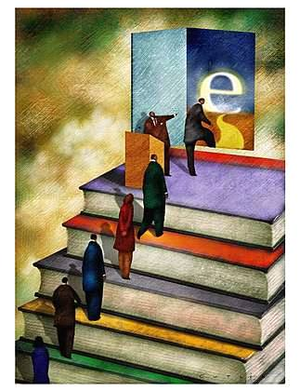
Developing & Maintaining eReader Policies and Procedures
Ming Heraty
Manager, Reference & Advisory Services
Arlington Heights Memorial Library
Arlington Heights, IL
WebJunction Webinar
January 31, 2012

Slide 36
Developing Procedures
Who, What, Where and Why
  Who can checkout?
  What eReaders to get?
  Where will they be kept?
  Why have eReaders?

Slide 37
Why have eReaders?
Allows users to try out the technology
Supports eBooks
Supports local authors
Allows the purchase of eBook titles in a format not available via OverDrive or other Library vendors

Slide 38
Selling the Idea
Addressing Administration and Board concerns
  Should we be doing this
  Security, Security, Security
  Setting up a Workgroup to develop a report
The MONEY!
  Friends of the Library Request (approx. $5000)
Vendor Permission

Slide 39
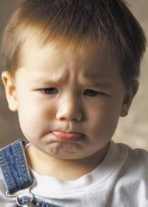
So Now Admin is on Board . . .
What about staff?
Training, Training, Training
Allow staff to have eReaders first
Agenda item for every staff meeting
Make it an appraisal goal

Slide 40
What eReaders to get
Kindles
  Initially purchased 10 devices w/10 titles
  Within 6 months added 10 more
  2011 added three specialty Kindles
Nooks
  The next year purchased 10 Nooks
  2011 Added 10 NookColors for Children’s Dept.
Sony Readers
  Purchased 10 at same time as Nooks
Reference Devices
  Kindle, Kindle Fire, Nook, Nook Tablet, iPad

Slide 41
AHML Circulating eReaders
23 Kindles
10 Nooks
10 NookColors
10 Sony Readers
On the Horizon
  iPads
  KindleFires

Slide 42
Who is the User
AHML resident cardholders
Any cardholder 12 years and up
Reservable
Two week checkout
Renewable
$1.00 a day fine

Slide 43
Where to keep them
Where do they live in your Library
  Shelving --so the public can find them
  Security
    We separate the eReader from the case
    Case goes out to the public
Location when they are being reviewed
  Office?
  Behind Circulation?

Slide 44
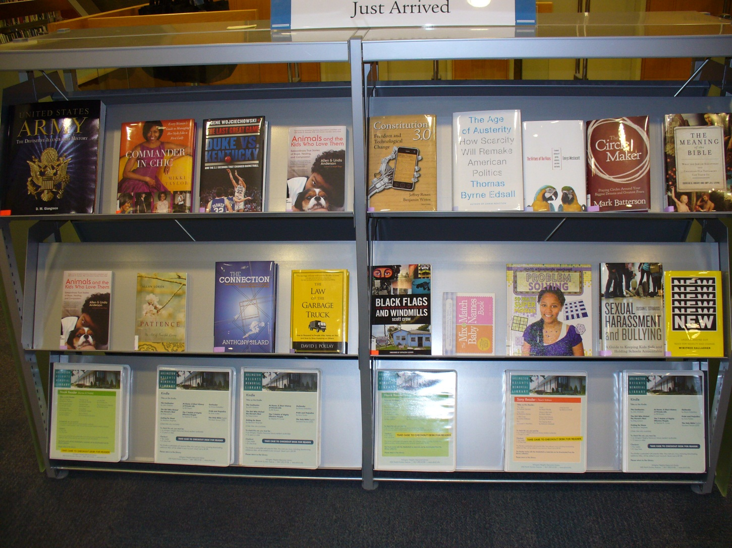
Shelving

Slide 45
Developing eReader Processes
From ordering titles to user
  Don’t re-invent the wheel
Circulation
Separate eReader from case
Case goes out to public
eReader kept behind Checkout
Patron takes case to Checkout for eReader
Tech Services
(Acquisitions)
Acquire Title
Advisory Clerk
Download to eReader
Tech Services
Catalog Title
Collection Mgmt
Choose Title
Notes:
Hint
•To create a flowchart, you can modify this example (copy & paste) or you can start from scratch to create your own flowchart.
To add flowchart shapes
In the Drawing group on the Home tab, click on the bottom “arrow” button next to the shapes, and find the Flowchart shapes.
Click on the shape that you want. Use the cursor to create the shape where you want it on the slide, and size it as you like.
To add connectors between the shapes
1. On the Drawing group, click on the bottom “arrow” button next to the shapes, and find the Lines shapes.
2. Point to where you want to lock the connector.
3. Click the first connection site you want, point to the other shape, and then click the second connection site.
•To delete the sample flowchart and these instructions, press Control + A and then Delete.

Slide 46
Developing eReader Processes
User returns eReader to Library
Circulation
Checks in item
Immediately checks it out to Review File
(Review File 48 hour turnaround)
eReader put on special shelves for Review behind Circulation
Circulation
Checks in item
(removes from Review File)
Checks for holds
Separates eReader from case
Puts case on cart to be shelved
Advisory Clerk
Picks up eReaders
Charges batteries
Checks for anomalies
Returns item to Circulation
Patron returns eReader
Book drop okay?
Collection Mgmt
Shelvers put case on Just Arrived shelves
Notes:
Hint
•To create a flowchart, you can modify this example (copy & paste) or you can start from scratch to create your own flowchart.
To add flowchart shapes
In the Drawing group on the Home tab, click on the bottom “arrow” button next to the shapes, and find the Flowchart shapes.
Click on the shape that you want. Use the cursor to create the shape where you want it on the slide, and size it as you like.
To add connectors between the shapes
1. On the Drawing group, click on the bottom “arrow” button next to the shapes, and find the Lines shapes.
2. Point to where you want to lock the connector.
3. Click the first connection site you want, point to the other shape, and then click the second connection site.
•To delete the sample flowchart and these instructions, press Control + A and then Delete.

Slide 47
What Should your eReaders Do?
Ability to download from your eBook collection
  Developing instructions for de-registered devices
Adding titles that are only available in eBook
Local self-publishers, romance and novellas

Slide 48
Managing the eReaders
Identify Staff Member as point person
  Heavy initial work
  Less involvement as time goes on—usually troubleshooting
Set Up email and vendor accounts
  Kindles have Amazon accounts
  Nooks have Barnes & Noble accounts
  Sony Readers have SonyStyle accounts
Set Up eReaders
  Register the eReader to the email and vendor account

Slide 49
When we Started . . .Where we Are
All adults had to sign a permission slip
Under the age of 18 had to have a parent or guardian sign
After 6 months with no problems we abandoned permission slips
No lost or stolen eReaders for 3 years

Slide 50
Damaged eReaders
Dropped and cracked eReaders
  Broken controller buttons
    Next page cracks
    Cracked screens
Broken cases
  Instruction inserts taken from cases
2-part cord, 1-part returned = phone call
  Vaccumming over cord—not good

Slide 51
eBooks to eReaders
Stand-alone OverDrive client since July 2011
Allow suggestions for purchase
Set-up instructions to email
Marketing

Slide 52
Contact Info
I would be happy to answer any questions.
Ming Heraty
mheraty@ahml.info
847.870.3669

Slide 53
Questions and Discussion
Notes:
Thank you everyone for coming to today’s webinar. I will send an email out afterwards with links to the archive.
You will be sent to a survey as you leave. We really appreciate your feedback on our webinar series.

Slide 54
Stay Involved
On WebJunction
  webjunction.org/mobile-devices
Crossroads (monthly newsletter)
  webjunction.org/crossroads
Events
  webjunction.org/events/webinars
Notes:
Thank you everyone for coming to today’s webinar. I will send an email out afterwards with links to the archive.
You will be sent to a survey as you leave. We really appreciate your feedback on our webinar series.

